Slide 1
Minimum Spanning Trees
Problem: Connect a set of nodes by a network of minimal total length
Some applications:
  Communication networks
  Circuit design
  Layout of highway systems
UNC Chapel Hill
Lin/Foskey/Manocha

Slide 2
Motivation: Minimum
Spanning Trees
To minimize the length of a connecting network, it never pays to have cycles.
The resulting connection graph is connected, undirected, and acyclic, i.e., a free tree (sometimes called simply a tree).
This is the minimum spanning tree or MST problem.
UNC Chapel Hill
Lin/Foskey/Manocha

Slide 3
Formal Definition of MST
Given a connected, undirected, graph G = (V, E), a spanning tree is an acyclic subset of edges T⊆ E that connects all the vertices together.
Assuming G is weighted, we define the cost of a spanning tree T to be the sum of edge weights in the spanning tree
w(T) = ∑_{(u,v)∈T} w(u,v)
A minimum spanning tree (MST) is a spanning tree of minimum weight.
UNC Chapel Hill
Lin/Foskey/Manocha

Slide 4
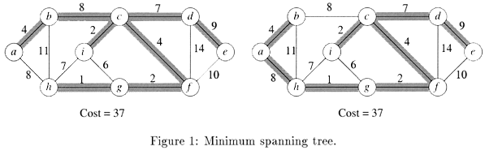
Figure1 : Examples of MST
Not only do the edges sum to the same value, but the same set of edge weights appear in the two MSTs. NOTE: An MST may not be unique.
UNC Chapel Hill
Lin/Foskey/Manocha

Slide 5
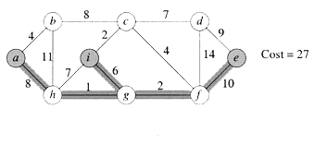
Steiner Minimum Trees (SMT)
Given a undirected graph G = (V, E) with edge weights and a subset of vertices V’ ⊆ V, called terminals. We wish to compute a connected acyclic subgraph of G that includes all terminals. MST is just a SMT with V’ =V.
Figure 2: Steiner Minimum Tree
UNC Chapel Hill
Lin/Foskey/Manocha

Slide 6
Generic Approaches
Two greedy algorithms for computing MSTs:
  Kruskal’s Algorithm (similar to connected component)
  Prim’s Algorithm (similar to Dijkstra’s Algorithm)
UNC Chapel Hill
Lin/Foskey/Manocha

Slide 7
Facts about (Free) Trees
A tree with n vertices has exactly n-1 edges
(|E| = |V| - 1)
There exists a unique path between any two vertices of a tree
Adding any edge to a tree creates a unique cycle; breaking any edge on this cycle restores a tree
For details see CLRS Appendix B.5.1
UNC Chapel Hill
Lin/Foskey/Manocha

Slide 8
Intuition Behind Greedy MST
We maintain in a subset of edges A, which will initially be empty, and we will add edges one at a time, until equals the MST. We say that a subset A⊆ E is viable if A is a subset of edges in some MST. We say that an edge (u,v) ∈ E-A is safe if A∪{(u,v)} is viable.
Basically, the choice (u,v) is a safe choice to add so that A can still be extended to form an MST. Note that if A is viable it cannot contain a cycle. A generic greedy algorithm operates by repeatedly adding any safe edge to the current spanning tree.
UNC Chapel Hill
Lin/Foskey/Manocha

Slide 9
Generic-MST (G, w)
1. A ← ∅ // A trivially satisfies invariant
// lines 2-4 maintain the invariant
2. while A does not form a spanning tree
3. do find an edge (u,v) that is safe for A
4. A ← A ∪ {(u,v)}
5. return A // A is now a MST
UNC Chapel Hill
Lin/Foskey/Manocha

Slide 10
Definitions
A cut (S, V-S) is just a partition of the vertices into 2 disjoint subsets. An edge (u, v) crosses the cut if one endpoint is in S and the other is in V-S. Given a subset of edges A, we say that a cut respects A if no edge in A crosses the cut.
An edge of E is a light edge crossing a cut, if among all edges crossing the cut, it has the minimum weight (the light edge may not be unique if there are duplicate edge weights).
UNC Chapel Hill
Lin/Foskey/Manocha

Slide 11
When is an Edge Safe?
If we have computed a partial MST, and we wish to know which edges can be added that do NOT induce a cycle in the current MST, any edge that crosses a respecting cut is a possible candidate.
Intuition says that since all edges crossing a respecting cut do not induce a cycle, then the lightest edge crossing a cut is a natural choice.
UNC Chapel Hill
Lin/Foskey/Manocha

Slide 12
MST Lemma
Let G = (V, E) be a connected, undirected graph with real-value weights on the edges. Let A be a viable subset of E (i.e. a subset of some MST), let (S, V-S) be any cut that respects A, and let (u,v) be a light edge crossing this cut. Then, the edge is safe for A.
UNC Chapel Hill
Lin/Foskey/Manocha

Slide 13
Step 1
Let T be any MST for G containing A.
  We know such a tree exists because A is viable.
If (u, v) is in T then we are done.
UNC Chapel Hill
Lin/Foskey/Manocha

Slide 14
MST Lemma: Reprise
Let G = (V, E) be a connected, undirected graph with real-value weights on the edges. Let A be a viable subset of E (i.e. a subset of some MST), let (S, V-S) be any cut that respects A, and let (u,v) be a light edge crossing this cut. Then, the edge is safe for A.
Point of Lemma: Greedy strategy works!
UNC Chapel Hill
Lin/Foskey/Manocha

Slide 15
Basics of Kruskal’s Algorithm
Attempts to add edges to A in increasing order of weight (lightest edge first)
  If the next edge does not induce a cycle among the current set of edges, then it is added to A.
  If it does, then this edge is passed over, and we consider the next edge in order.
  As this algorithm runs, the edges of A will induce a forest on the vertices and the trees of this forest are merged together until we have a single tree containing all vertices.
UNC Chapel Hill
Lin/Foskey/Manocha

Slide 16
Detecting a Cycle
We can perform a DFS on subgraph induced by the edges of A, but this takes too much time.
Use “disjoint set UNION-FIND” data structure. This data structure supports 3 operations:
  Create-Set(u): create a set containing u.
  Find-Set(u): Find the set that contains u.
  Union(u, v): Merge the sets containing u and v.
Each can be performed in O(lg n) time.
The vertices of the graph will be elements to be stored in the sets; the sets will be vertices in each tree of A (stored as a simple list of edges).
UNC Chapel Hill
Lin/Foskey/Manocha

Slide 17
MST-Kruskal(G, w)
1. A ← ∅ // initially A is empty
2. for each vertex v ∈ V[G] // line 2-3 takes O(V) time
3. do Create-Set(v) // create set for each vertex
4. sort the edges of E by nondecreasing weight w
5. for each edge (u,v) ∈ E, in order by nondecreasing weight
6. do if Find-Set(u) ≠ Find-Set(v) // u&v on different trees
7. then A ← A ∪ {(u,v)}
8. Union(u,v)
9. return A
Total running time is O(E lg E).
UNC Chapel Hill
Lin/Foskey/Manocha

Slide 18
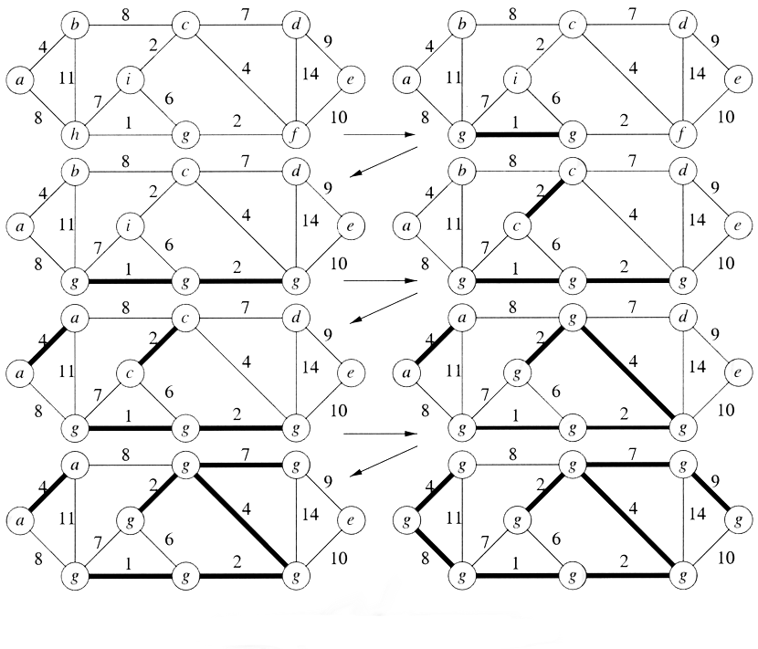
Example: Kruskal’s Algorithm
Figure 4: Kruskal’s Algorithm
UNC Chapel Hill
Lin/Foskey/Manocha

Slide 19
Analysis of Kruskal
Lines 1-3 (initialization): O(V)
Line 4 (sorting): O(E lg E)
Lines 6-8 (set-operation): O(E log E)
Total: O(E log E)
UNC Chapel Hill
Lin/Foskey/Manocha

Slide 20
Correctness
Consider the edge (u, v) that the algorithm seeks to add next, and suppose that this edge does not induce a cycle in A. Let A’ denote the tree of the forest A that contains vertex u. Consider the cut (A’, V-A’). Every edge crossing the cut is not in A, and so this cut respects A, and (u, v) is the light edge across the cut (because any lighter edge would have been considered earlier by the algorithm). Thus, by the MST Lemma, (u,v) is safe.
UNC Chapel Hill
Lin/Foskey/Manocha

